Slide 1
Crime and Weather in Chicago
ITM 529 Advanced Data Analytics
March 22, 2016
Fabián Moreno

Slide 2
Agenda
Introduction
Business Scenario
Business Objective
Data
Source
Integration
Dataset
Analysis
Model
Regression Model
Outliers
Conclusions

Slide 3
Introduction

Slide 4
Business Scenario
City of Chicago is cutting law enforcement funds
Crime in Chicago is rampant
CPD needs to optimize resources to fight crime with less expenditure
Weather in Chicago ranges from extreme conditions
Operative resources are more expensive during the winter
A model of correlation between crime and weather may be of help

Slide 5
Business Objective
Optimize resource allocation according to weather forecast
Hypothesis 1: Weather affects crime rates in Chicago
Hypothesis 2: Temperature is positively correlated with crime rates

Slide 6
Data

Slide 7
DFD
SOURCE
INTEGRATION
RESULTS
CITY OF CHICAGO
CRIME
CSV
DATASET
SAS
ANALYSIS
WUNDERGROUND
WEATHER
HTML

Slide 8
Data source
Crime in Chicago
City of Chicago Data Portal (Open Data)
21 attributes
6,000,000+ observations (!)
2001 - 2015
Exported to CSV
1 file: 1.2 GB
Weather in Chicago
Wunderground (Free Data)
23 attributes
5500 observations
2001 - 2015
Exported to HTML
15 files: 0.5 MB

Slide 9
Data Integration
Crime in Chicago
Attributes reduced to 2
Observations reduced to 2013 - 2015: 1M
Date transformation to ‘Number’
Grouped by Date + Crime summary: 1K+
Weather in Chicago
Attributes reduced to 11
Observations reduced to 2013 - 2015: 1K+
Date transformation to ‘Number’

Slide 10
Dataset
Crime in Chicago
Date: day
Crimes: crime rate
Weather in Chicago
Date: day
TMaxC: max temperature in Cº
TMeanC: mean temperature in Cº
TMinC: min temperature in Cº
VMaxKm: max visibility in Km
VMeanKm: mean visibility in Km
VMinKm: min visibility in Km
WSMaxKmH: max wind speed in KmH
WSMeanKmH: mean wind speed in KmH
PMm: precipitation in Mm
Cloud: cloud index
Events: weather incidents

Slide 11
Analysis

Slide 12
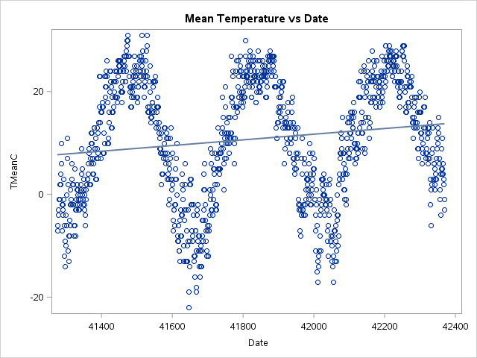
3 years of daily measures
Clear patterns
Top values: Summer
Bottom values: Winter
Slight increase of temperature: evidence of Global Warming
Cold days are not as cold anymore
Hot days are still hot

Slide 13
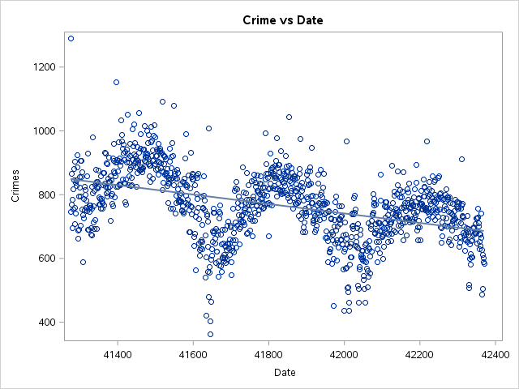
3 years of daily measures
Clear patterns
Top values: high crime (Summer)
Bottom values: low crime (Winter)
Clear decreasing trend of crime even though temperature increases
Outliers on New Year’s day

Slide 14
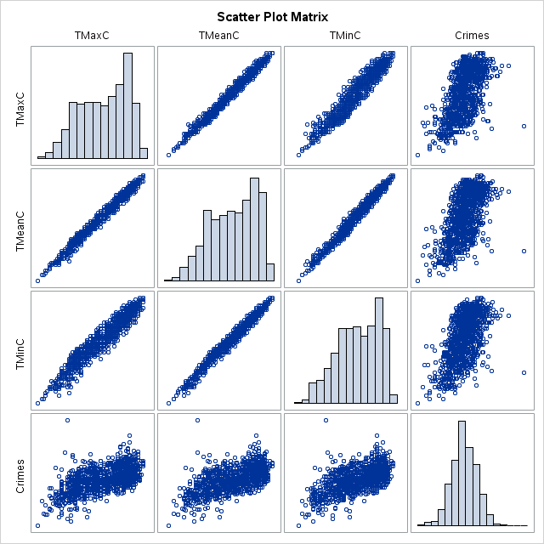
3 attributes of temperature
Maximum
Mean
Minimum
Mean temperature has less variability
Mean temperature is selected for the temperature vs crime analysis

Slide 15
Correlation Crime vs Temperature
Temperature | Correlation | P
Min | 0.5984 | 2E-107
Mean | 0.6078 | 1E-111
Max | 0.6035 | 1E-109

Slide 16
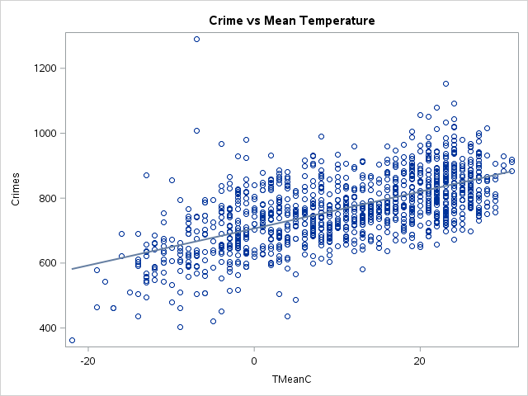
Clear visualization of correlation between crime and mean temperature
The higher the mean temperature is the more crime there is
The lower the mean temperature is the less crime there is

Slide 17
Model

Slide 18
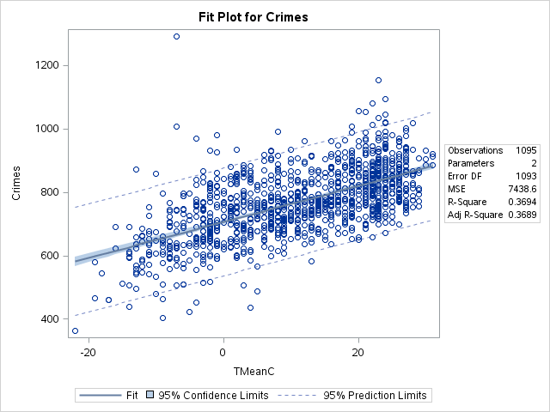

Slide 19
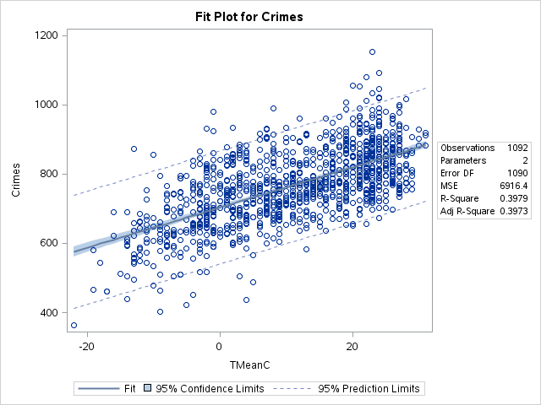
Regression without outliers
Model fits better

Slide 20
Outlier Analysis
Dataset’ TMeanC mean: 10
Dataset’ Crimes mean: 767
Outliers are New Year’s day
Outliers | Correlation | P
Yes | 0.6078 | <.0001
No | 0.63078 | <.0001
Year | TMeanC | Dec 31st | New Year’s | Jan 2nd
2013 | -7 | 737 | 1291 | 746
2014 | -7 | 558 | 1008 | 479
2015 | -4 | 573 | 968 | 663

Slide 21
Conclusions
Not all weather conditions affect crime rates
Not visibility
Not wind speed
Not precipitation
Not cloud index
Only temperature
Mean temperature affects crime
Hot day: high crime
Mild day: mild crime
Cold day: low crime
New Year’s: peak

Slide 22
Thank you!

